Slide 1
Effect Size Tutorial:
Cohen’s d and Omega Squared
Jason R. Finley
Mon April 1st, 02013
http://www.jasonfinley.com/tools
Notes:
Created and presented while post-doc at Washington University in St. Louis

Slide 2

ω²
DEAL WITH IT
Notes:
DEAL WITH IT
If you don't believe that effect sizes are awesome you better get a life right now or they will chop your head off!!! It's an easy choice, if you ask me.

Slide 3
Effect Sizes to use
Comparison of means (t test):
  Cohen’s d
    Calculate using Pooled SD (I’ll demonstrate)
Correlation:
  r is its own effect size! (or r², whatever)
Regression:
  R², R²_{change}, R²_{adjusted}
ANOVA:
  Eta squared η²
  Omega squared ω²
Standardized
Difference
Proportion of
Variance
Explained
“Strength of
Association” (Hays)
Notes:
Cohen’s d: a standardized difference measure
R^2 squared multiple correlation
http://onlinestatbook.com/2/effect_size/variance_explained.html

Slide 4
Effect size for comparing two groups:
Cohen’s d
Between-Ss or within-Ss t-test
Effective range: -3 to 3
Use pooled SD, and say that’s what you did!
“Effect sizes for comparisons of means are reported as Cohen’s d calculated using the pooled standard deviation of the groups being compared (Olejnik & Algina, 2000, Box 1 Option B).”
Note this is not the raw variance of the sample, but rather the variance adjusted to be an unbiased estimator of the population variance. That is. It’s based on using N-1, instead of N.
Notes:
Cortina & Nouri 2000 Eq 1.1
Olejnik & Algina 2000 p245
Keppel & Wickens 2004 p160 (via Fritz, Morris, & Richler, 2012)
Note: effect size for a SINGLE-SAMPLE t or z test is just the sample mean divided by the sample SD.
effec size for a z-test of differences is just the z statistic itself, since it is already a standardized difference of means.
Practically, you won’t usually see d values more extreme than around, say 1.25.

Slide 5
 | Condition A |  | Condition B
 | 0.5 |  | 0.5
 | 0.25 |  | 0.5
 | 0.75 |  | 1
 | 0.5 |  | 0.25
 | 0 |  | 0.5
 | 0.25 |  | 0.5
 | 0 |  | 0
 | 0 |  | 0.5
mean | 0.28 |  | 0.47
Variance (adjusted) | 0.07 |  | 0.07
df | 7 |  | 7
=AVERAGE(D2:D9)
=VAR(D2:D9)
=COUNT(D2:D9)-1
Then just plug the values into a formula in Excel
Notes:
Do the same for between or within Ss.
Note: formula uses the adjusted variance ( =VAR() ), not the raw variance ( =VARP() ).

Slide 6
Single-sample t-test, z-test?
effect size for a SINGLE-SAMPLE t or z test is just the sample mean divided by the sample SD.
effect size for a z-test of differences is just the z statistic itself, since it is already a standardized difference of means.

Slide 7
ANOVA vs Regression
Eta squared ... R²
Epsilon squared ... R²adj
Omega squared ... No equivalent, but could be done
Notes:
Camp & Maxwell 1983
possible R^2 analogue to omega squared

Slide 8
Effect Sizes for ANOVA: η² vs. ω²
Equivalent to R² in regression!
Eta squared η²
  Proportion of variance in DV accounted for by IV(s)
  Partial eta squared η²_{partial}
    For designs with 2+ IVs
    Prop. var. accounted for by one particular IV
  Range: 0-1
  Problems:
    η² is descriptive of the SAMPLE data
    Biased: overestimates population effect size
      Especially when sample size is small
Notes:
Refs for ANOVA vs Regression effect sizes:
S. F. Matter (2000). Regression, ANOVA, and estimates of effect size. Bulletin of the Ecological Society of America, January, 74-76.
C. J. Camp & S. E. Maxwell 1983). A comparison of various strengths of association measures commonly used in gerontological research. Journal of Gerontology, 38(1), 3-7.
Eta squared also sometimes referred to as R squared. Also may be called correlation ratio
Partial eta: partials out variance accounted for by other factors in design

Slide 9
Effect Sizes for ANOVA: η² vs. ω²
Omega squared ω²
  INFERENTIAL: estimates population effect size
    Prop. var. in DV accounted for by IV
  Way less biased than η² (will be smaller)
  Partial omega squared
  Issues:
    Not reported by SPSS
    Can turn out negative (set to 0 if this happens)
    Formula slightly different for different designs
    Put a hat on it (ESTIMATED)
small: .01
med: .06
large: .14
Notes:
No equivalent in regression
Rough guideline of small/med/large. (Kirk, 1996)

Slide 10
1-way between-subjects ANOVA
Overall effect size (we’ll get to partial in a minute)
All values needed are obtained from ANOVA table
=
Notes:
Omega squared for different effects, designs: numerator has same general form, just swap in appropriate SS and MSerror (MSE different for differnet effects)
Alt formula from Olejnik & Algina (2000) p. 266
I used the alternate form of the formula because it allowed for better consistency across different designs. (?)
Dfeffect: # groups in IV manipulation (minus 1). So omega takes this into account

Slide 11
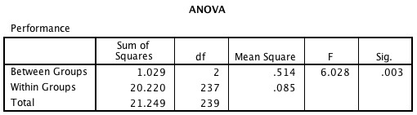
SPSS output for
1-way between-Ss ANOVA
effect
error
HINT: paste the SPSS output into Excel!... Make a template!
Notes:
Trick: paste into excel

Slide 12
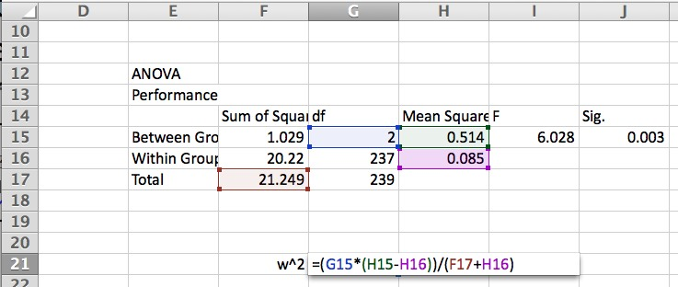

Slide 13
1-way within-subjects ANOVA

Slide 14
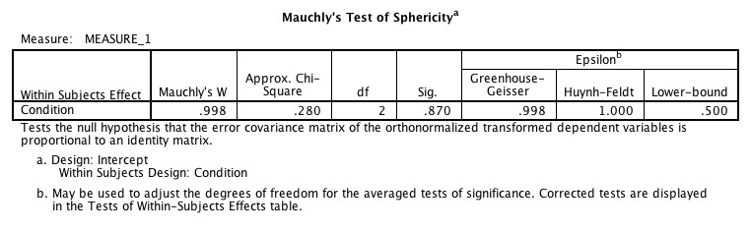
SPSS output for
1-way within-Ss ANOVA
Test for violation of sphericity is not sig., so we can use the “Sphericity Assumed” rows in the tables to follow.
Notes:
If Mauchly’s test is sig (p<.05), assume sphericity assumption violated, and use one of the corrections (GG, HF, LB).
NOTE: only have to worry about this is have more than 2 conditions in any IV.

Slide 15
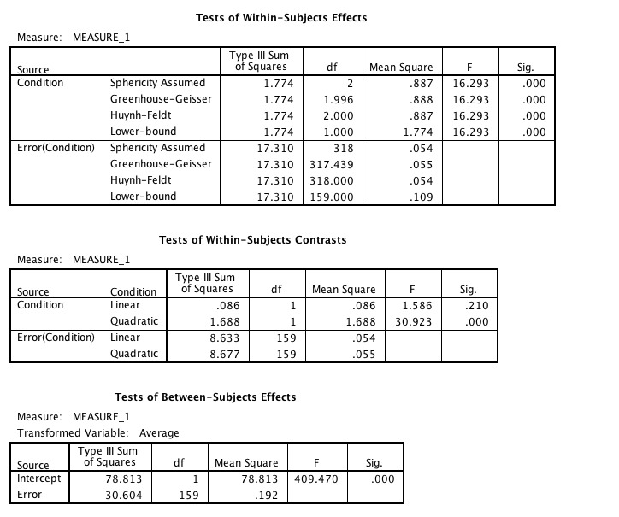
SPSS output for
1-way between-Ss ANOVA
effect
effect x subject
subject
Notes:
Have to manually add up SStotal from the three sources. (ignore the “Intercept” line)

Slide 16
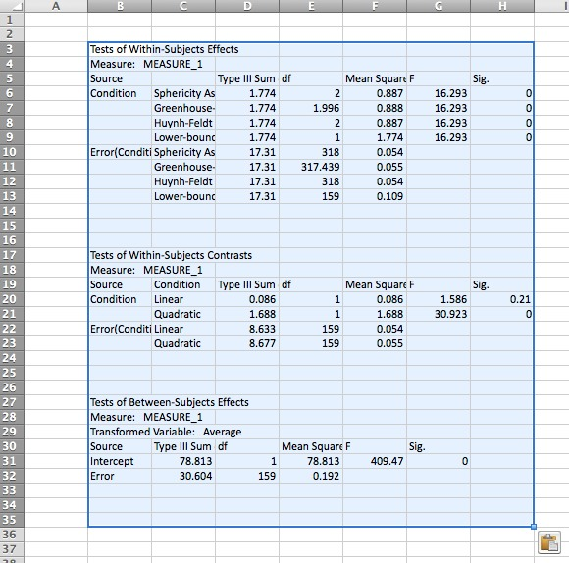
Notes:
Paste into Excel, make your formula

Slide 17
Partial Omega Squared
When 2+ IVs
  Prop. var. in DV accounted for by one particular IV, partialing out variance accounted for by the other IVs.
or
Notes:
M&D reasoning: we want partial omega squared to be what we would have gotten if ran experiment with just that one IV.
Note alt formulas...

Slide 18
2-way Between-Ss ANOVA: with IVs “A” and “B”
For IV “A”:
Regular
Partial
N_{total} = total # subjects in experiment
Notes:
IV = independent variable, DV = dependent variable

Slide 19
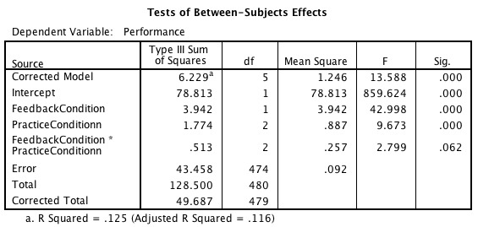
SPSS output for 2-way between-Ss ANOVA
IV A: Feedback Condition
IV B: Practice Condition
Partial
Notes:
If doing regular omega squared, and need SStotal, Use the “Corrected total” row (excludes intercept)

Slide 20
SPSS output for 2-way between-Ss ANOVA
IV A: Feedback Condition
IV B: Practice Condition
Regular
Notes:
If doing regular omega squared, and need SStotal, Use the “Corrected total” row (excludes intercept)

Slide 21
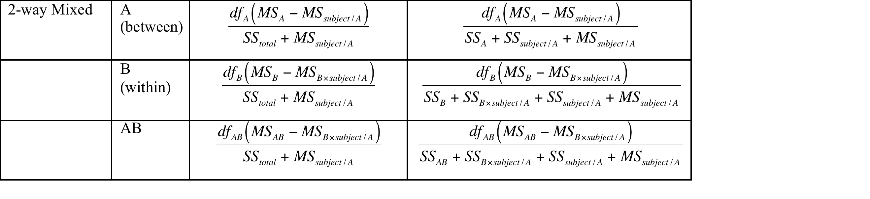
2-way mixed ANOVA
(IV “A” between-Ss, IV “B” within-Ss)
Pro tip: the AB interaction counts as a within-Ss effect
Notes:
Aka Split plot design
Comes down to selecting the appropriate SS and error terms.

Slide 22
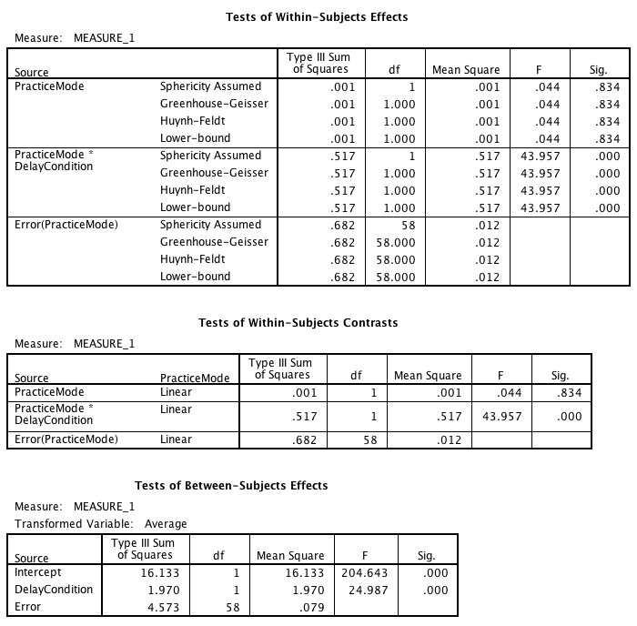
Effect B
Interaction AB
Error B, AB:
“Bxsubject/A”
For interaction AB:
Effect A
Error A: “subject/A”

Slide 23
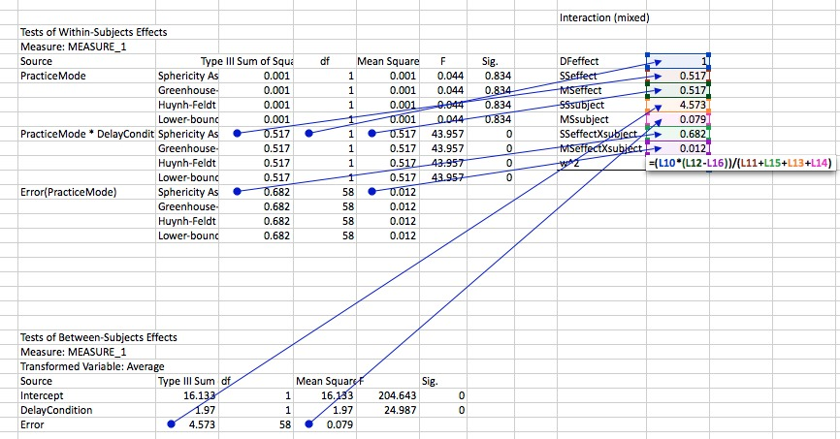
Notes:
Paste the relevant tables from SPSS into Excel, make your formula.

Slide 24
REMEMBER
In the first paragraph of your Results section (just Exp. 1 if multiple exps), clearly state the effect sizes you’ll be reporting.
“Effect sizes for comparisons of means are reported as Cohen’s d calculated using the pooled standard deviation of the groups being compared (Olejnik & Algina, 2000, Box 1 Option B).”
“Effect sizes for ANOVAs are reported as partial omega squared calculated using the formulae provided by Maxwell and Delaney (2004).”

Slide 25
On the horizon
Confidence intervals for effect size estimates
Notes:
Maybe?:
Steigler & Fouladi (1997)
Fidler & Thompson (2001)

